Slide 1
CSE 320/EEE361 Data Communications
Digital Transmission
Chapter 4

Slide 2
Recap Previous Lecture
Digital data
Analog data
Digital Signal
Analog Signal
Digital Signal
Analog Signal
Which option to choose?
Requirements to meet
Media & communications facilities

Slide 3
Encoding Techniques
Digital Data, Digital Signal
Less expensive and less complex than digital to analog modulation.
Digital Data, Analog Signals
Some transmission media, such as optical fiber and unguided media , will only propagate analog signals.

Slide 4
Digital Data → Digital Signal
Signal Encoding Techniques:
Line Coding
- Diffrent Line Coding Schemes
Block Coding
Scrambling
Line coding is always needed; block coding and scrambling may or may not be needed.

Slide 5
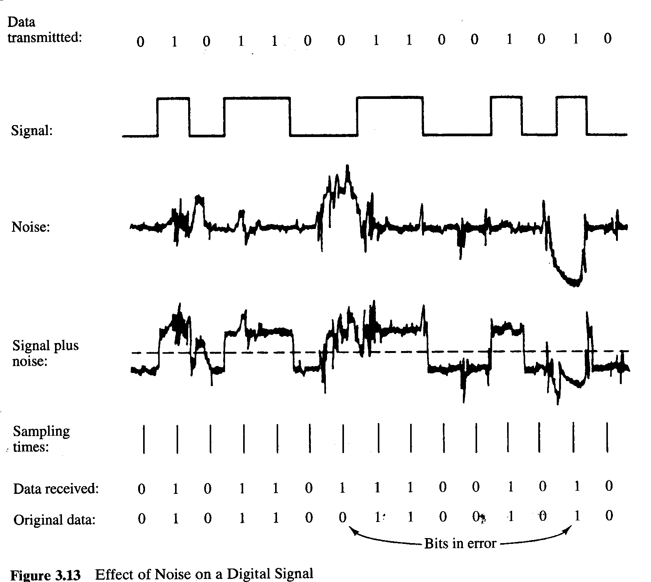
Digital Data, Digital Signal
Digital signal
Discrete, discontinuous voltage pulses
Each pulse is a signal element
Binary data encoded into signal elements

Slide 6
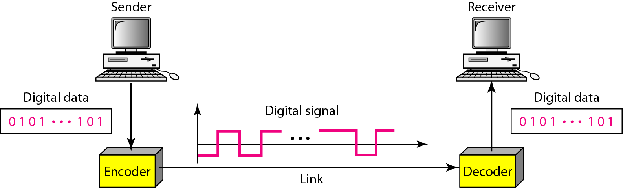
Line Coding
Line coding is the process of converting binary data, a sequence of bits, to a digital signal.

Slide 7
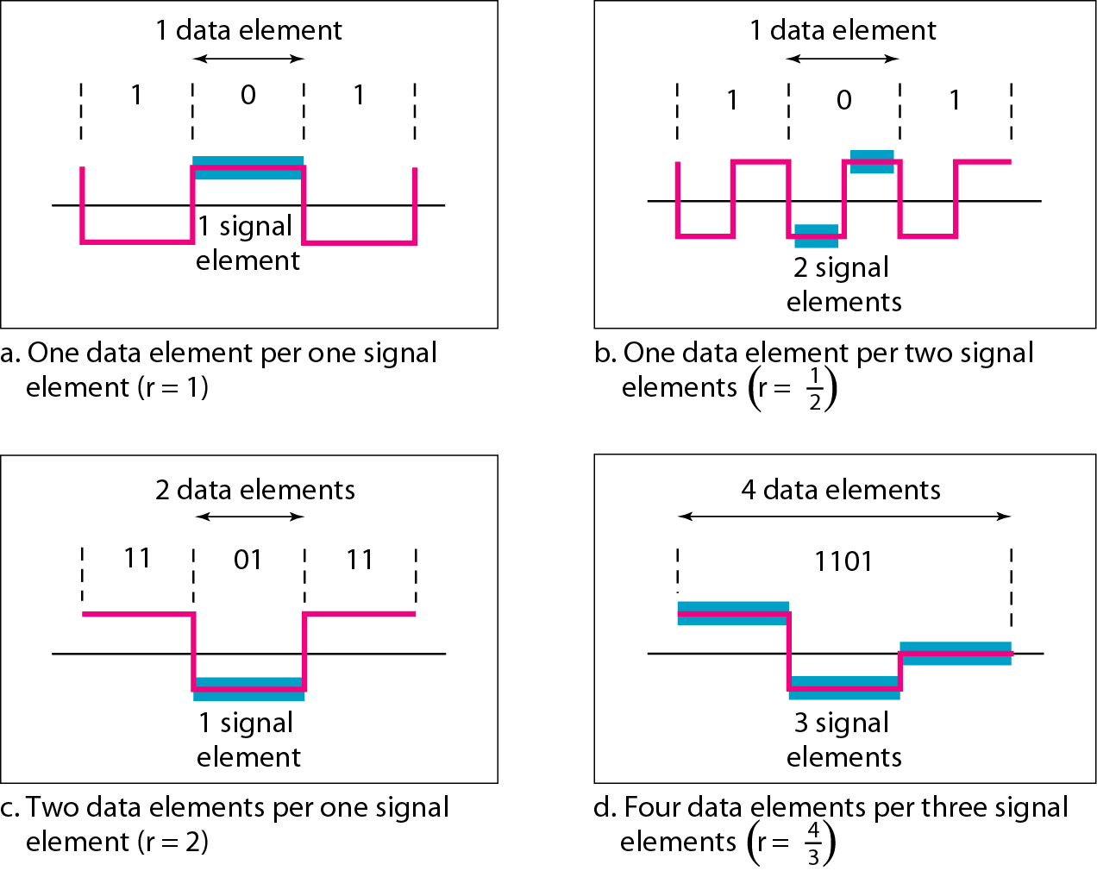
Signal Vs Data Element

Slide 8
Pulse /Modulation /Signal/ Baud Rate versus Bit Rate
The pulse rate defines the number of pulses/signals sent in one second. Also known as Baud Rate.
The bit rate defines the number of bits per second.

Slide 9
Digital Data → Digital Signal
Receiver needs to know
Timing of bits
Signal levels
Factors affecting successful interpretation of signals
Baseline Wandering
DC Components
Self-synchronization
Built in Error Detection
Immunity to Noise and Interference
Complexity
Signal-to-Noise ratio (SNR)
E_{b}/N₀
Data Rate
Bandwidth

Slide 10
BaseLine Wandering
Receiver calculates the running average of received signal power.
Average = baseline
A log strings of 0’s and 1’s can cause a drift in the baseline making it difficult for the receiver to decode properly.

Slide 11
DC Components
When the voltage level in a digital signal is constant for a while, the spectrum creates very low frequencies (results of Fourier analysis).
If the signal is to pass through a system (such as a transformer) that does not allow the passage of a dc component, the signal is distorted and may create errors in the output.
This component is extra energy residing on the line and is useless.

Slide 12
Self-Synchronization
The receiver’s bit intervals must correspond exactly to the senders bit intervals.
If the receiver clock is faster or slower, the bit intervals are not matched and the receiver might misinterpret the signals.

Slide 13
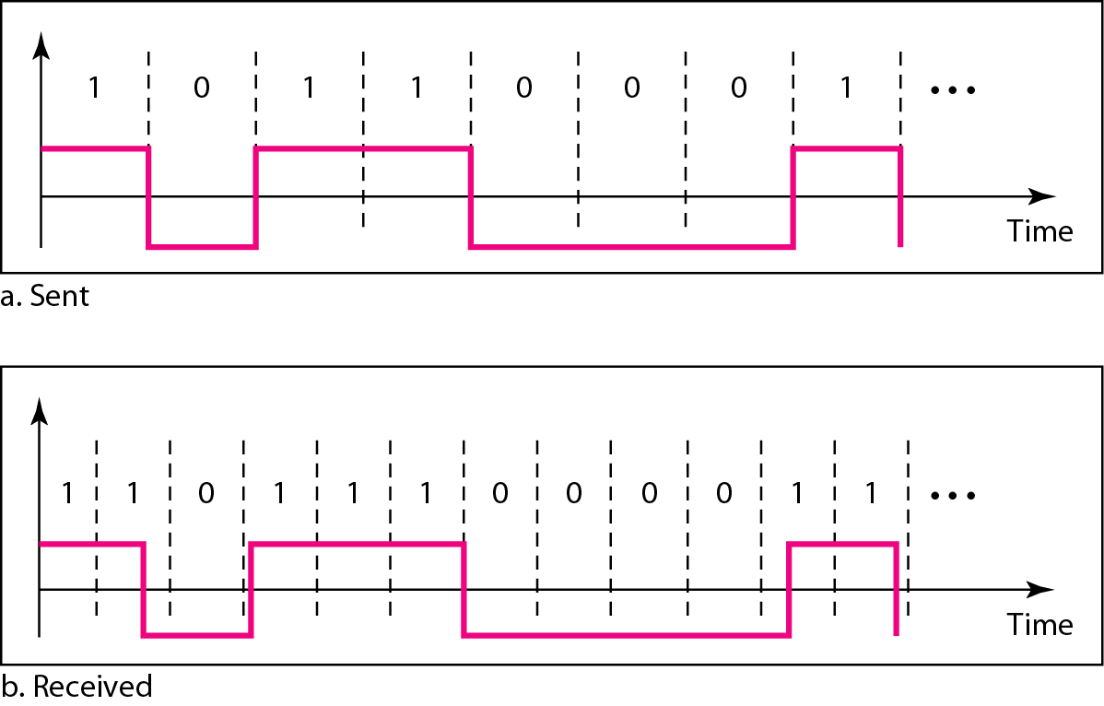
Figure 4.3 Effect of lack of synchronization

Slide 14
Self-Synchronization
A self-synchronizing digital signal includes timing information in the data being transmitted.
This can be achieved if there are transitions in the signal that alert the receiver to the beginning, middle, or end of the pulse.
If the receiver’s clock is out of synchronization, these points can reset the clock.

Slide 15
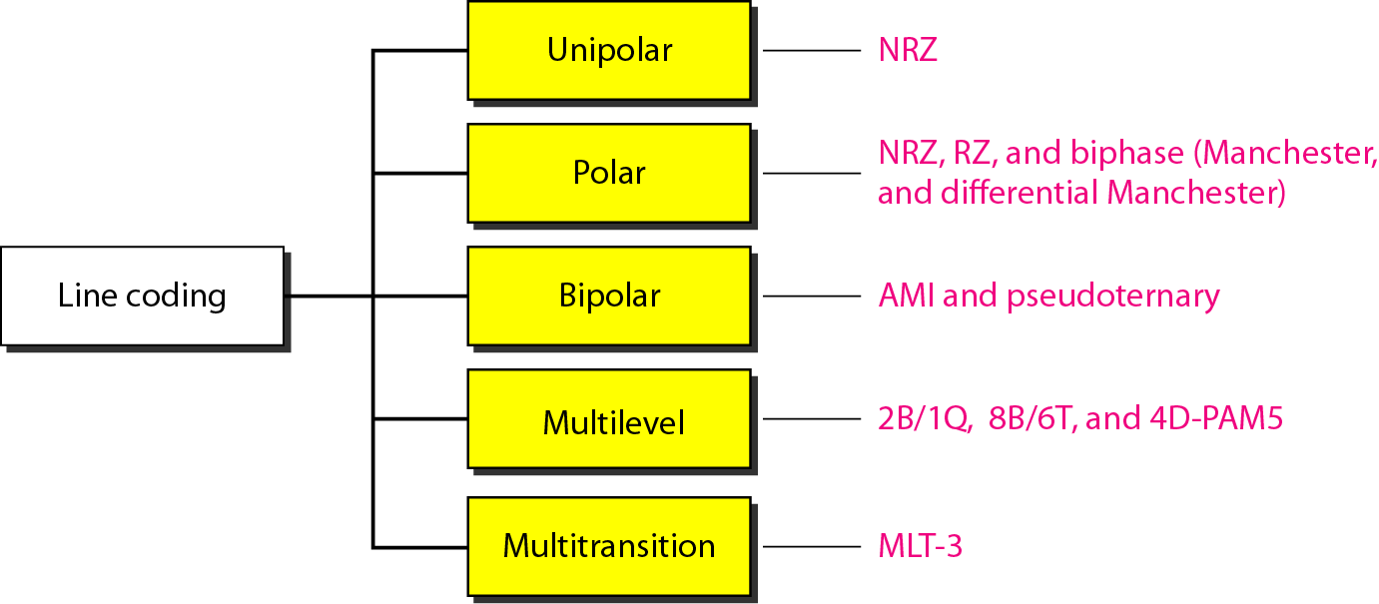
Different Line Encoding Schemes

Slide 16
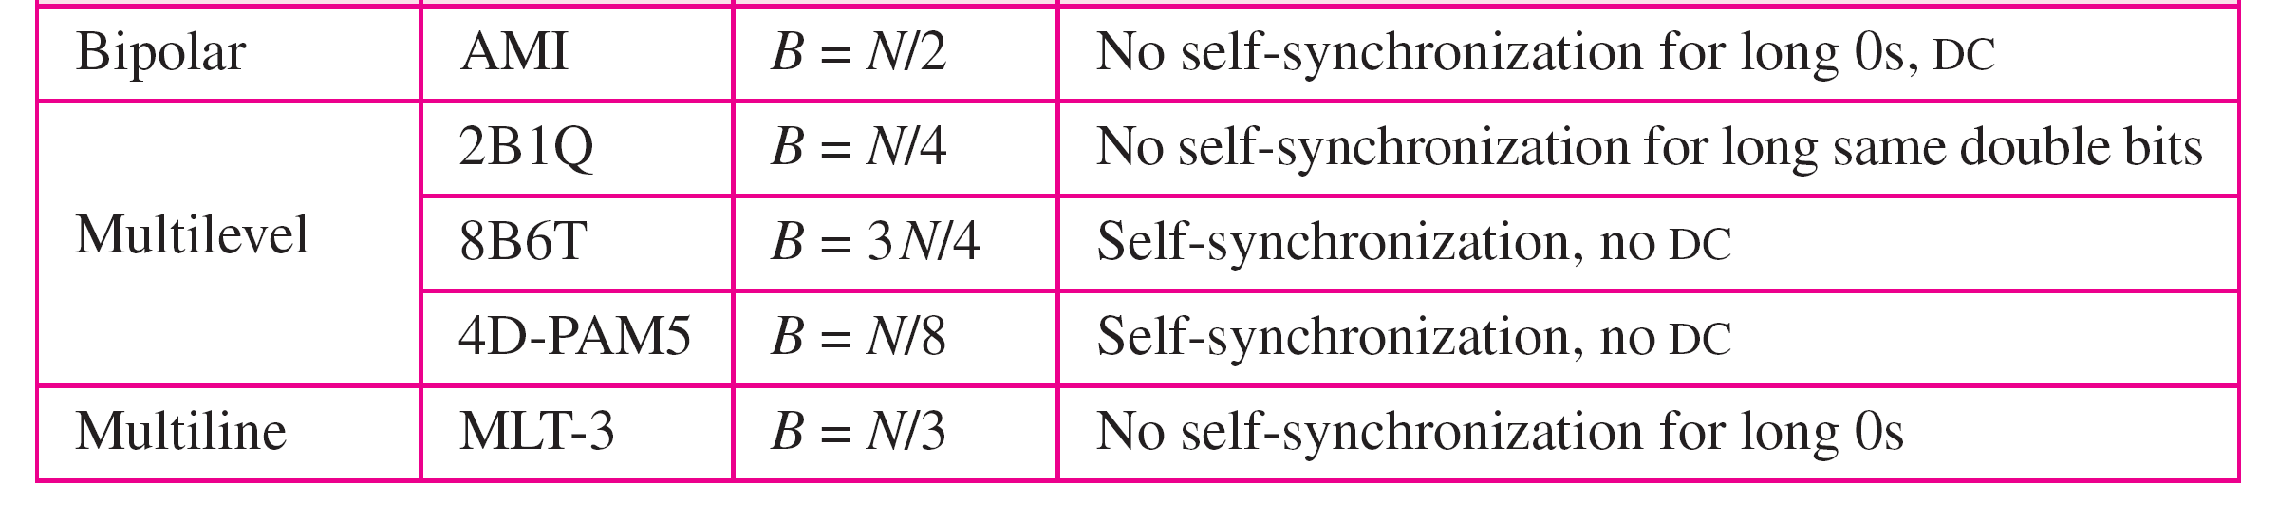
Table 4.1 Summary of line coding schemes

Slide 17
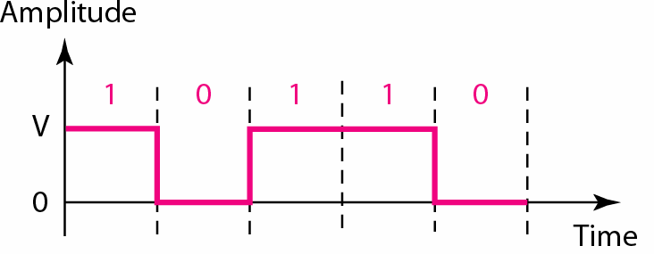
Unipolar

Slide 18
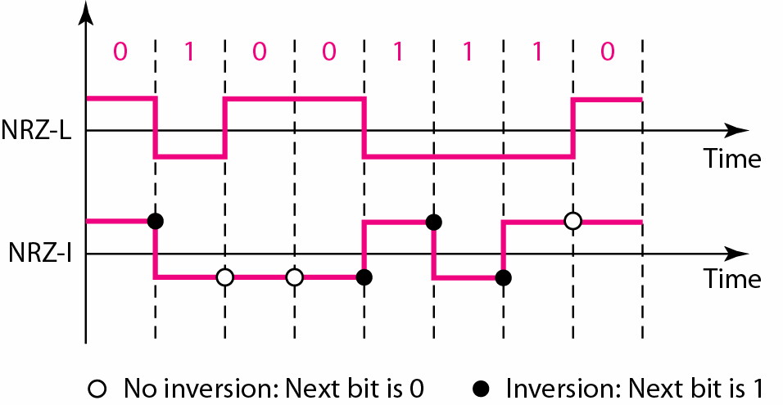
NRZ-L & NRZ-I (Bipolar)

Slide 19
Nonreturn to Zero (NRZ)
0 1 0 0 1 1 0 0 0 1 1
NRZ-L
NRZI
Notes:
NRZ
Two different voltages for 0 and 1 bits
Voltage constant during bit interval
No transition (i.e. no return to zero voltage)
Options:
1. Absence of voltage for zero, constant positive voltage for one
2. More often, negative voltage for one value and positive for the other
NRZI
Inverted on ones
Constant voltage pulse for duration of bit
Data encoded as presence or absence of signal transition at beginning of bit time
Transition (low to high or high to low) denotes a binary 1
No transition denotes binary 0
An example of differential encoding

Slide 20
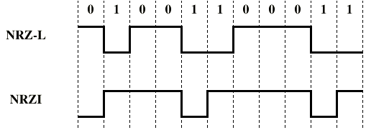
NRZ

Slide 21
NRZ – Pros and Cons
Pros
Easy to engineer
Make good use of bandwidth
Cons
DC component
Lack of synchronization capability
Used for magnetic recording
Not often used for signal transmission

Slide 22
Differential Encoding
In complex transmission layouts, it is easy to lose sense of polarity
Therefore
Data represented by changes (i.e., transitions) rather than levels
More reliable detection of transition rather than level

Slide 23
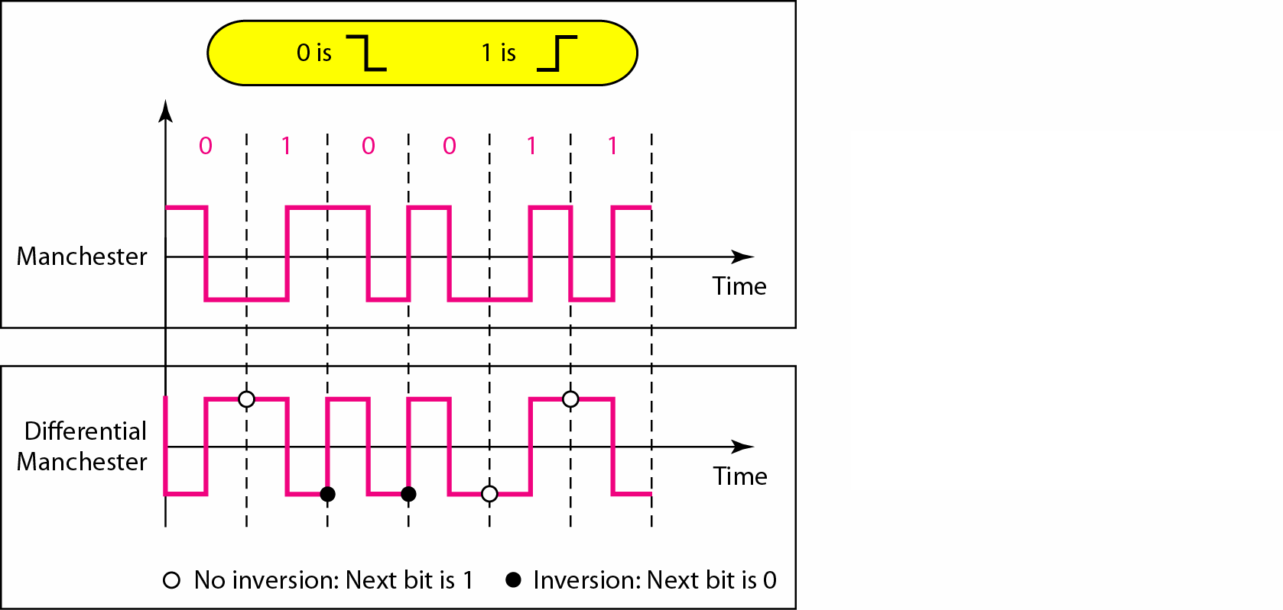
Manchester Encoding & Differential Manchester Encoding

Slide 24
Biphase (Manchester and D-Manchester)
0 1 0 0 1 1 0 0 0 1 1
Man
D-Man
Notes:
Manchester
Transition in middle of each bit period
Transition serves as clock and data
Low to high represents 1
High to low represents 0
Used by IEEE 802.3 (Ethernet LAN)
Differential Manchester
Mid-bit transition is clocking only
Transition at start of a bit period represents 0
No transition at start of a bit period represents 1
This is a differential encoding scheme
Used by IEEE 802.5 (Token Ring LAN)

Slide 25
Biphase -- Pros and Cons
Pros
Synchronization on mid bit transition (self clocking)
No dc component
Error detection
Absence of expected transition
Cons
At least one transition per bit time and possibly two
Maximum modulation rate is twice NRZ
Requires more bandwidth

Slide 26
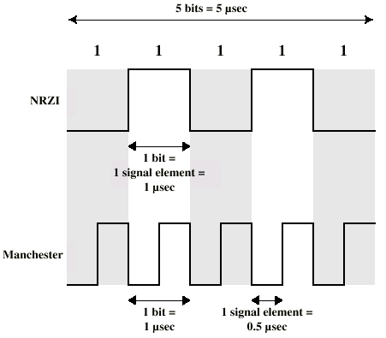
Modulation Rate

Slide 27
Multilevel Binary
Use more than two levels
Bipolar-AMI
zero represented by no line signal
one represented by positive or negative pulse
No loss of sync if a long string of ones (zeros still a problem)
Lower bandwidth

Slide 28
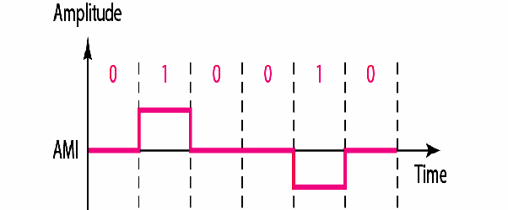
Bipolar-AMI

Slide 29
Multilevel Transition, three level- MLT-3,
There is no transition at the beginning of a 0 bit.
The signal transitions from one level to the next at the beginning of a 1 bit
Transition occurs using three levels of signals (+1, 0, -1).

Slide 30
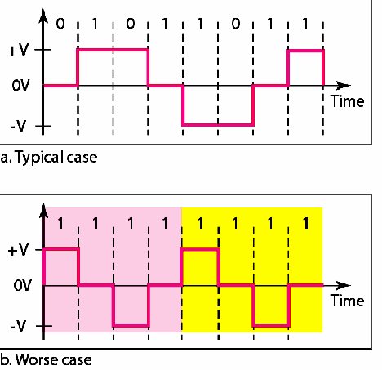
MLT-3

Slide 31
Biploar AMI and MLT-3 Example
0 1 0 0 1 1 1 0 0 1 1
Biploar
AMI
MLT-3
Notes:
Manchester
Transition in middle of each bit period
Transition serves as clock and data
Low to high represents 1
High to low represents 0
Used by IEEE 802.3 (Ethernet LAN)
Differential Manchester
Mid-bit transition is clocking only
Transition at start of a bit period represents 0
No transition at start of a bit period represents 1
This is a differential encoding scheme
Used by IEEE 802.5 (Token Ring LAN)

Slide 32
Block Coding

Slide 33
Block Coding/Scrambling
NRZ, Bipolar AMI, MLT-3 all has a common problem.
Long sequence of 0 can make the receiver lose synchronization
Solutions:
Change the bit stream before encoding with NRZ-I so that there is no long streams of 0s.

Slide 34
Solutions:
Block Coding
Scrambling
Block Coding
Changes a block of m bits to a block of n bits.
Referred to as mB/nB encoding.

Slide 35
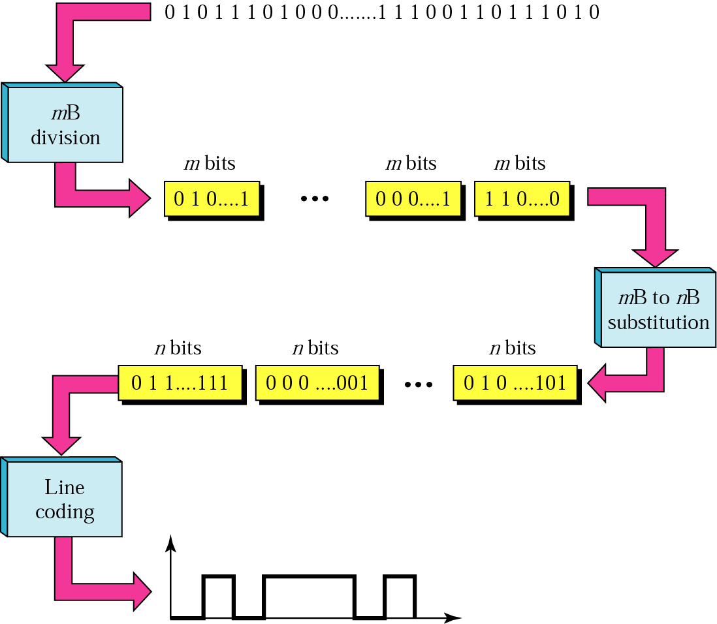
Block Coding
Three Steps Process:
Division
Substitution
Line Coding
/Combination

Slide 36
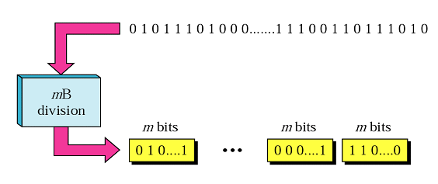
Step 1-Division
The sequence of bits in data in divided into m Bits.
For example in 4B/5B encoding, the original bit sequence is divided into 4-bit codes/sequence.

Slide 37
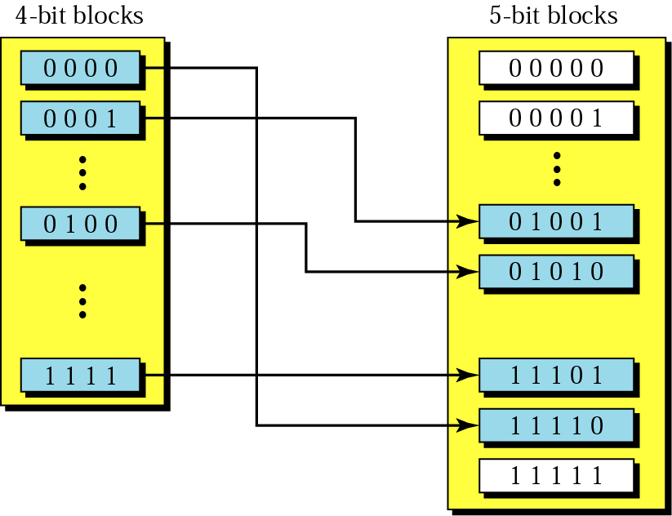
Step 2-Substitution
Each m bits sequence is substituted for a n bit code.

Slide 38
4B/5B Block Coding
4-bit code ==16 different combinations
5-bit code== 32 possible combinations.
So not all of 5-bit codes are required.
Selection of the 5-bit code is such that each code contains no more than
“one leading 0 and no more than two trailing 0s.” (3 consecutive 0s)

Slide 39
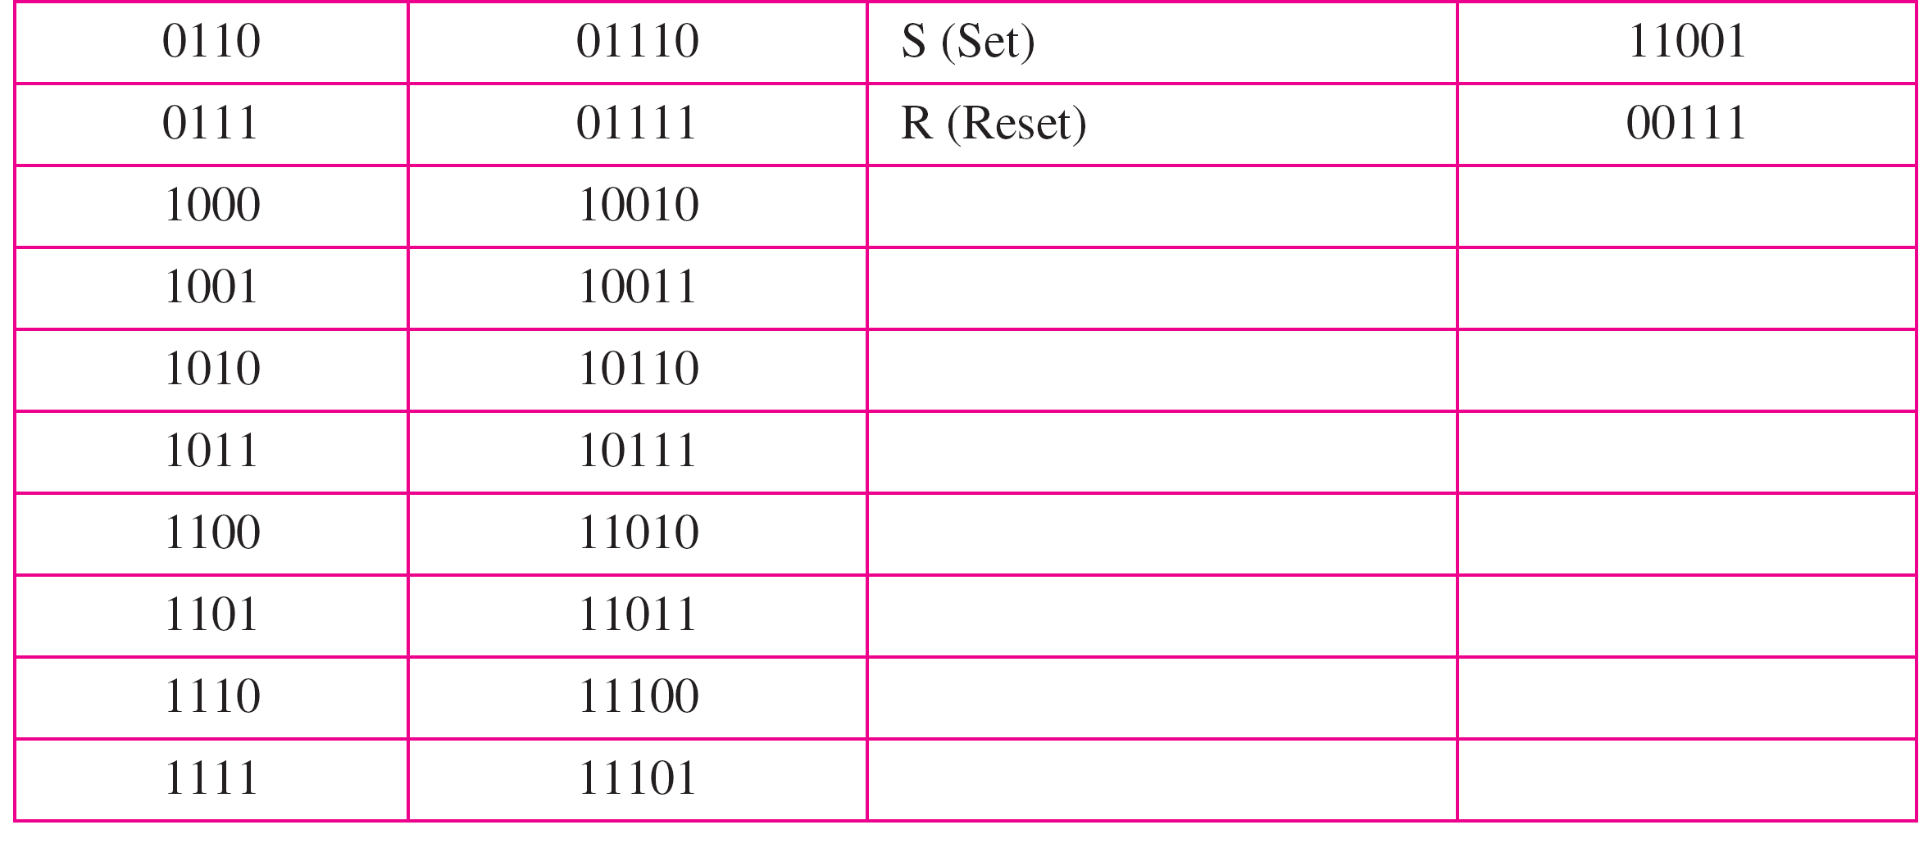
Table : 4B/5B encoding

Slide 40
Step 3: Line Coding
After substitution, a line coding scheme, exp NRZ-I is chosen to create a signal.
A very simple line coding scheme is chosen, because the block coding procedure provides
two desirable features (??) of complex line coding schemes.

Slide 41
Block Coding-Pros/Cons
Solves the synchronization problem but not the DC component problem.
If DC is unacceptable, use bipolar or biphase encoding.
Increases the baud rate by 20%, still better than Manchester schemes.

Slide 42
Scrambling
Use scrambling to replace sequences that would produce constant voltage
Filling sequence
Must be recognized by receiver and replace with original
Same length as original
Design Goals
No dc component
No long sequences of zero level line signal
No reduction in data rate
Error detection capability

Slide 43
Types of Scarmbling:
B8ZS
Bipolar With 8 Zeros Substitution
Commonly used US.
HDB3
High Density Bipolar 3 Zeros
Based on Bipolar AMI
Commonly used Europe and Japan.

Slide 44
B8ZS
Based on bipolar-AMI
If octet of all zeros and last voltage pulse preceding was positive encode as 000+-0-+
If octet of all zeros and last voltage pulse preceding was negative encode as 000-+0+-
Causes two violations of AMI code
Unlikely to occur as a result of noise

Slide 45
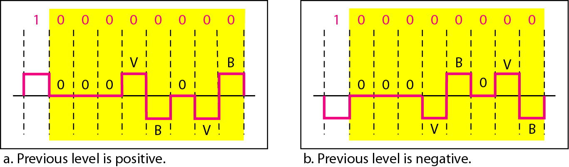
B8ZS

Slide 46
HDB3
High Density Bipolar 3 Zeros
Based on Bipolar AMI, Commonly used Europe and Japan.
Based on bipolar-AMI
String of four zeros replaced with one or two pulses

Slide 47
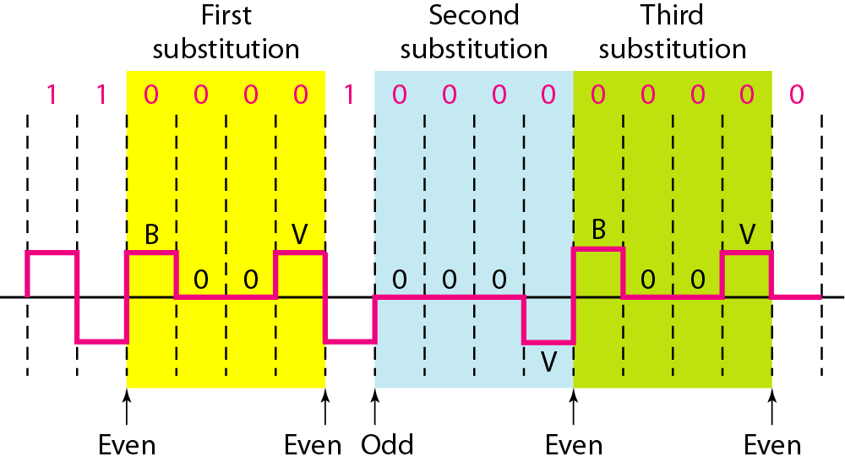
HDB3

Slide 48
4-2 Analog Data → Digital Signal

Slide 49
Analog Data, Digital Signals
To send human voice over a long distance
It is needed to digitize since digital signals are less prone to noise.
This is called analog-to-digital conversion or digitizing an analog signal.

Slide 50
Analog Data → Digital Signal
Topics discussed in this section:
Pulse Code Modulation (PCM) Delta Modulation (DM)

Slide 51
PCM is made up of four separate process
PAM
Quantization
Binary encoding
Digital-to-digital encoding

Slide 52
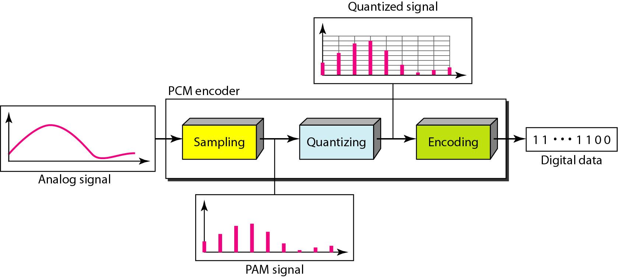
Pulse Code Modulation

Slide 53
Pulse Amplitude Modulation (PAM)
This technique
takes an analog signal
samples it
generates a series of pulses based on the results of sampling
Sampling:- means measuring the amplitude of the signal at equal intervals.

Slide 54
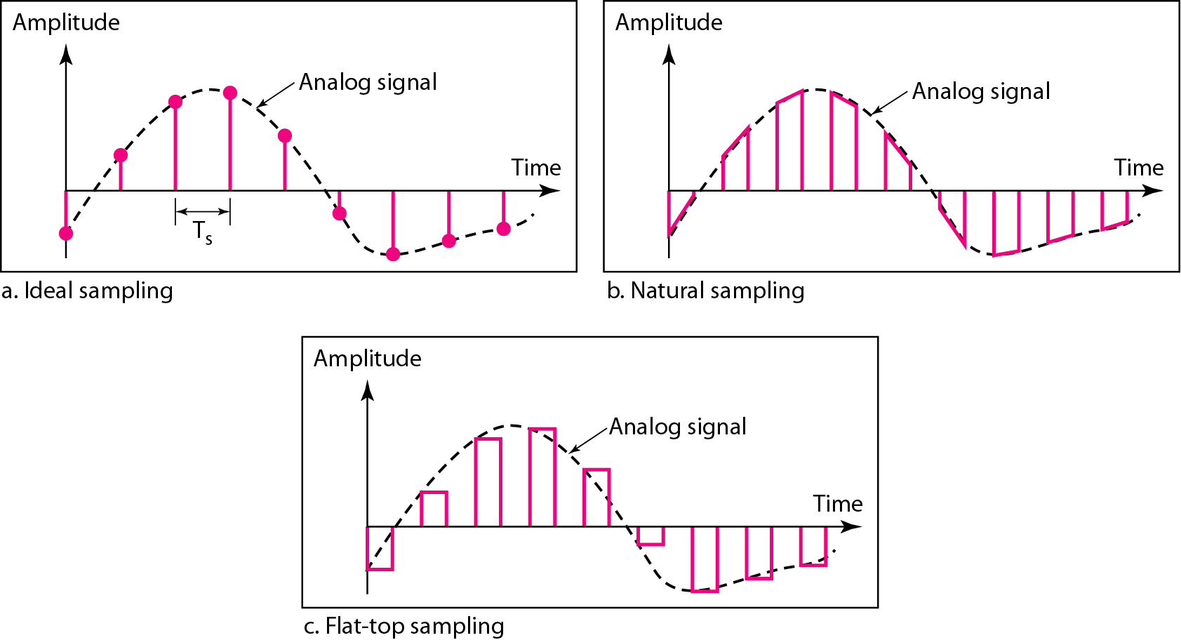
Three different sampling methods for PCM

Slide 55
PAM
PAM uses a technique called sample and hold.

Slide 56
PAM--Technique
Still an analog signal, not digital
To make the pulses digital Pulse code modulation (PCM) is used.
Thus PAM is the foundation of an important analog-to-digital conversion method like pulse code modulation (PCM).

Slide 57
Figure 4.21 Components of PCM encoder

Slide 58

Note
According to the Nyquist theorem, the sampling rate must be
at least 2 times the highest frequency contained in the signal.

Slide 59
Example 4.6
For an intuitive example of the Nyquist theorem, let us sample a simple sine wave at three sampling rates: f_{s} = 4f (2 times the Nyquist rate), f_{s} = 2f (Nyquist rate), and f_{s} = f (one-half the Nyquist rate). Figure 4.24 shows the sampling and the subsequent recovery of the signal.
It can be seen that sampling at the Nyquist rate can create a good approximation of the original sine wave (part a). Oversampling in part b can also create the same approximation, but it is redundant and unnecessary. Sampling below the Nyquist rate (part c) does not produce a signal that looks like the original sine wave.

Slide 60
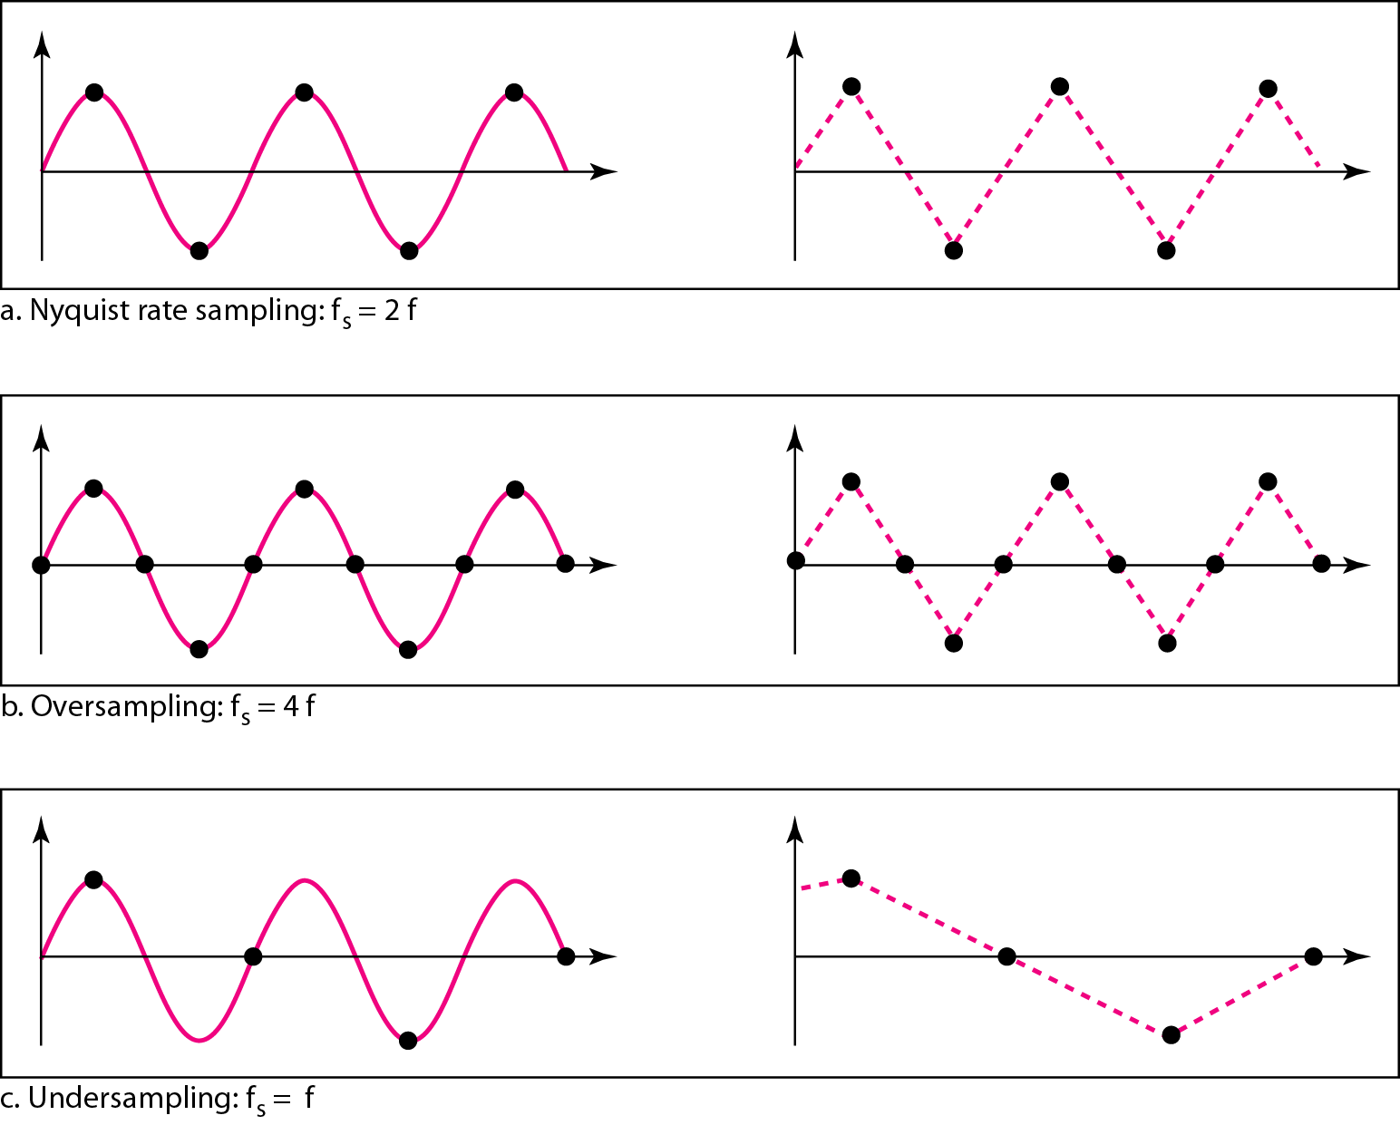
Figure 4.24 Recovery of a sampled sine wave for different sampling rates

Slide 61
Example 4.9
Telephone companies digitize voice by assuming a maximum frequency of 4000 Hz. The sampling rate therefore is 8000 samples per second.

Slide 62
PCM
Technique involves:
First quantizes the PAM pulses
Each value is translated into its seven-bit binary equivalent, the eighth bit indicates the sign.
The binary digits are then transformed into a digital signal by using any one of the digital-to –digital encoding techniques.

Slide 63
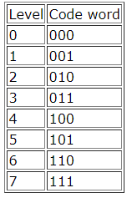
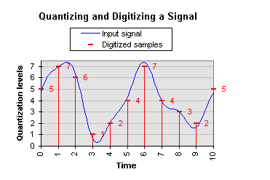
Example 1
The signal is sampled at 11 time points using 8 quantization segments. That is level is 8.
All the values that fall into a specific segment are approximated with the corresponding quantization level which lies in the middle of a segment.

Slide 64
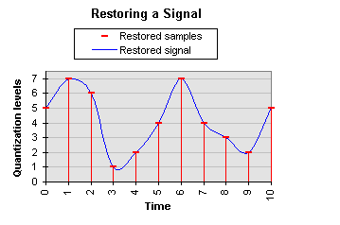
Example 1
The restored signal is formed according to taken samples. It can be noticed that the restored signal diverges from the input signal.
PCM encoded signal in binary form: 101 111 110 001 010 100 111 100 011 010 101 Total of 33 bits were used to encode a signal.

Slide 65

Example 2: Quantization
Sampling is a series of pulses with amplitude values between the max and min amplitudes of the signal.
The set of amplitudes can be infinite with nonintegral values between the two limits. These values cannot be used in the encoding process.
The following are the steps in quantization:
Assume that the original analog signal has instantaneous amplitudes between Vmin and Vmax.
Divide the range into L zones, each of height Δ (delta).
We assign quantized values of 0 to L − 1 to the midpoint of each zone.

Slide 66
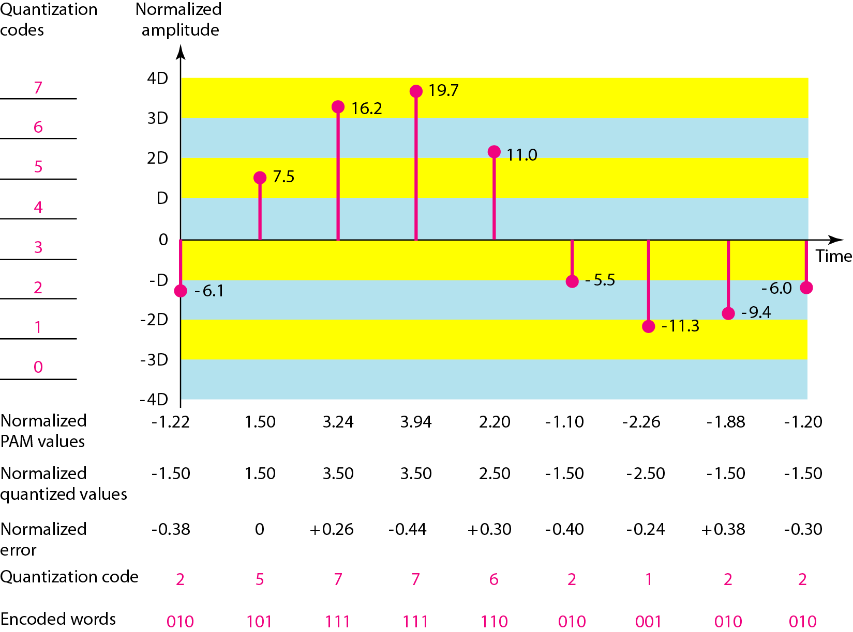
Figure 4.26 Quantization and encoding of a sampled signal

Slide 67
Example 4.14
We want to digitize the human voice. What is the bit rate, assuming 8 bits per sample?
Solution
The human voice normally contains frequencies from 0 to 4000 Hz. So the sampling rate and bit rate are calculated as follows:

Slide 68
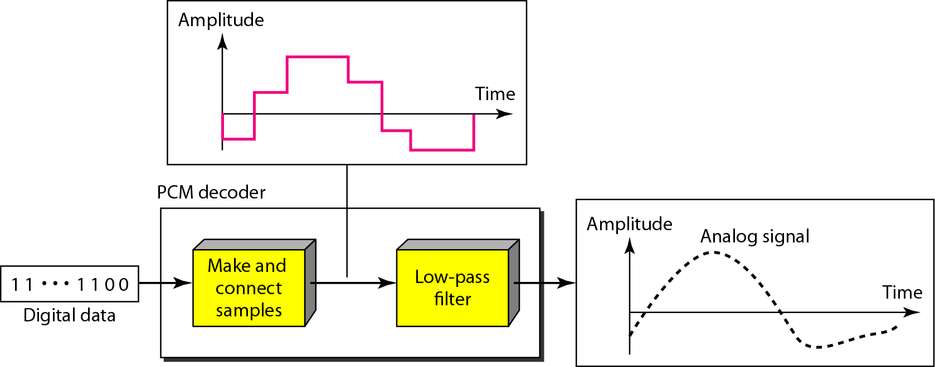
Figure 4.27 Components of a PCM decoder

Slide 69
Delta Modulation

Slide 70
Delta Modulation
To improve the performance of PCM (reduce complexity)
Analog input is approximated by a staircase function
Move up or down one quantization level (δ) at each sample interval
Binary behavior—important characteristic
Function moves up or down at each sample interval

Slide 71
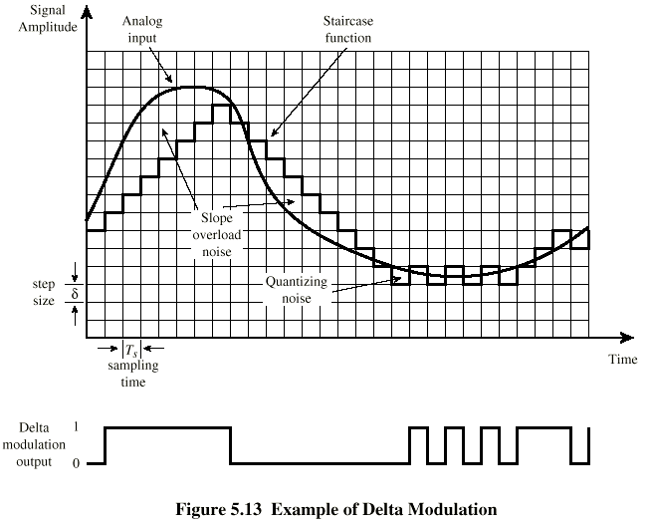
Delta Modulation - example

Slide 72
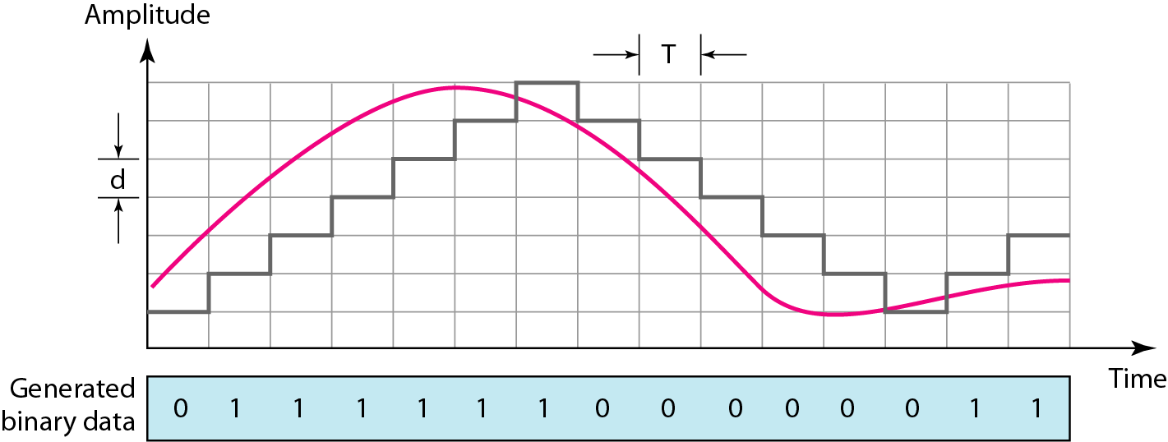
The process of delta modulation

Slide 73
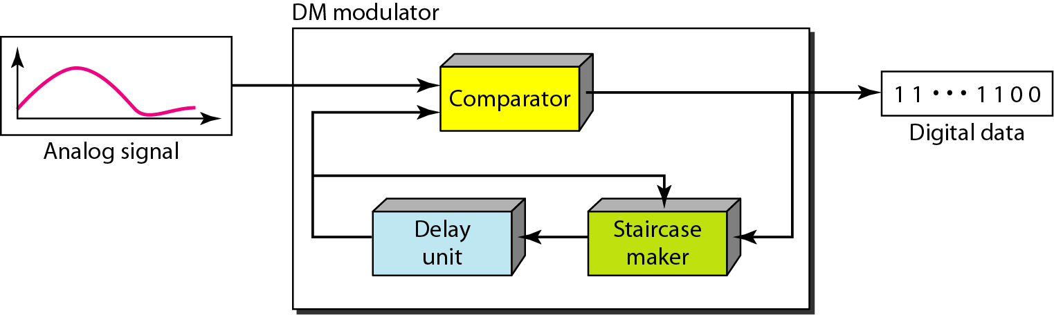
Figure 4.29 Delta modulation components

Slide 74
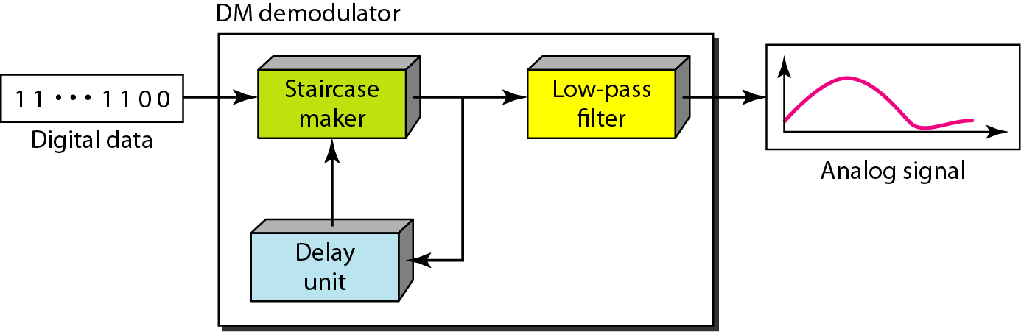
Figure 4.30 Delta demodulation components

Slide 75
Delta Modulation (3)
2 important parameters are
size of the step δ
the sampling rate.

